Slide 1
INFDEV036A – Algorithms Lesson unit 1
G. Costantini, F. Di Giacomo
costg@hr.nl, giacf@hr.nl – Office H4.206

Slide 2
Course description in a nutshell
Why this course?
Algorithms + Data structures = Program
Prerequisite
Object oriented programming
Language for practical exam
C#
In the lessons mainly pseudocode

Slide 3
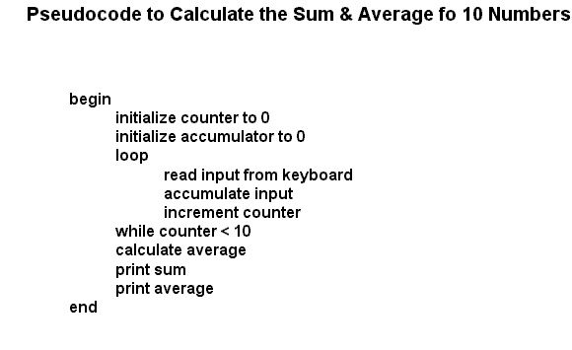
What is pseudo-code?
Informal description of a computer program
does not actually obey the syntax rules of any particular language
omits non-essential details
can include natural language

Slide 4
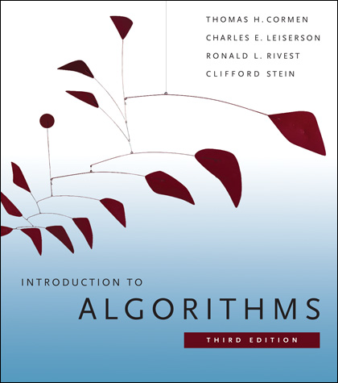
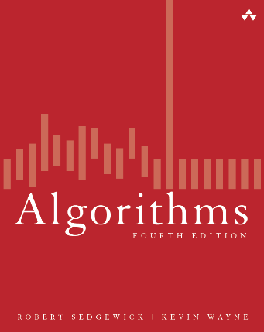
Literature
All lesson materials (slides, mainly): on N@tschool
MC questions: on GrandeOmega
Introduction to Algorithms, T. H. Cormen, C. Stein, R. L. Rivest, C. E. Leiserson, The MIT Press, ISBN: 978-0-262-53305-8, 3de editie, 2009
Complete and general
BIBLE OF ALGORITHMS AND EVERYTHING REMOTELY RELATED
Another book (optional):
Algorithms, R. Sedgewick, K. Wayne, Addison Wesley, ISBN-13: 978-0321573513, 4th edition, 2011
Code and all examples in Java
http://algs4.cs.princeton.edu/

Slide 5
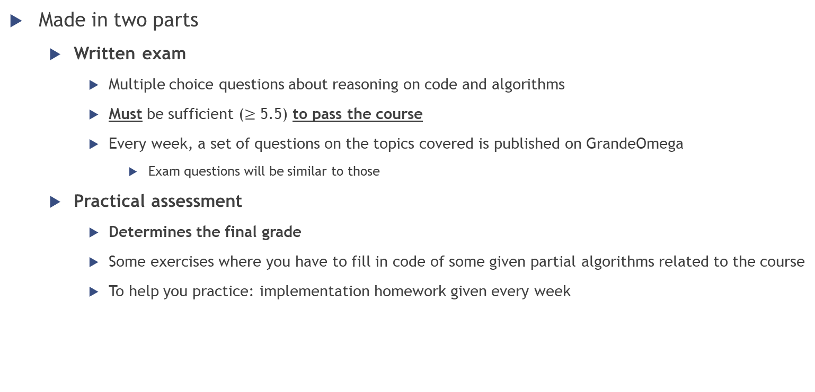
Assessment
Made in two parts
Written exam
Multiple choice questions about reasoning on code and algorithms
Must be sufficient ($≥$ 5.5) to pass the course
Every week, a set of questions on the topics covered is published on GrandeOmega
Exam questions will be similar to those
Practical assessment
Determines the final grade
Some exercises where you have to fill in code of some given partial algorithms related to the course
To help you practice: implementation homework given every week

Slide 6

How do I pass the course (with a good grade)?
Pay attention to the lessons
Do all given homework (multiple times)
Study the slides
MC questions
Implementation exercises

Slide 7

General rules
Attendance is NOT mandatory
If you are not interested in following the lesson:
please leave the room
Else:
sit at the front of the room
be silent while the teacher is talking
participate actively to the lesson
answer when questions are asked
give feedback

Slide 8
Questions answered by the course
Why is my code slow?
Empirical and complexity analysis
How do I order my data?
Sorting algorithms
How do I structure my data?
Linear, tabular, recursive data structures
How do I represent relationship networks?
Graphs

Slide 9
Today
Why is my code slow?
Empirical and complexity analysis
How do I order my data?
Sorting algorithms
How do I structure my data?
Linear, tabular, recursive data structures
How do I represent relationship networks?
Graphs

Slide 10
More detailed agenda
Intro
Recap on arrays
Our first (simple) algorithms, operating on arrays
How to measure performance
Empirical analysis
Complexity analysis

Slide 11
Arrays: a quick summary
Definition, Basic manipulation & properties, Search algorithms

Slide 12

Array
Definition?
Ordered list of values
Object that consists of a sequence of elements numbered 0, 1, 2, …
Each value has a numeric index
Index number
Array of size $N→$ indices from $0$ to $N−1$
0 1 2 3 4 5 6 7 8 9
79 87 94 82 67 98 87 81 74 91

Slide 13
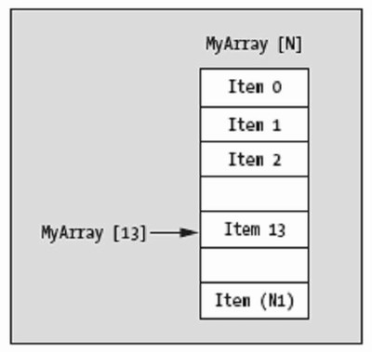
Array – Indexing notation
Access to elements through their index
Usually done with the subscript operator []
Very efficient because of cache alignment and tightness of representation (no additional data besides content)
NOT TRUE IN JAVA because of ref’s everywhere

Slide 14
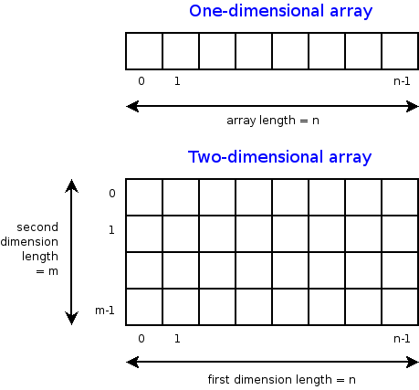
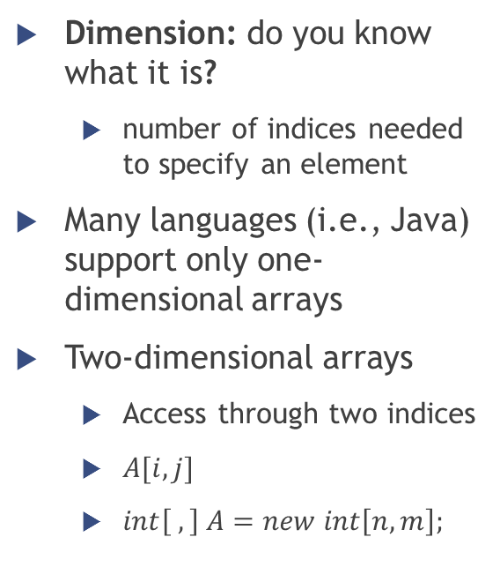
Multidimensional arrays
Dimension: do you know what it is?
number of indices needed to specify an element
Many languages (i.e., Java) support only one-dimensional arrays
Two-dimensional arrays
Access through two indices
$A[i,j]$
$int\left[ ,\right] A=new int\left[n,m\right];$

Slide 15
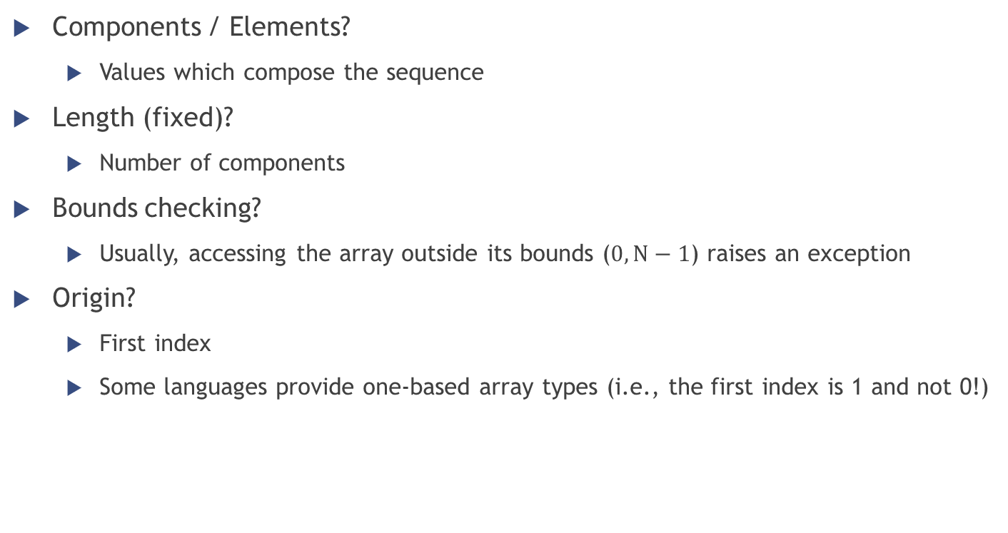
Array – Terminology, properties
Components / Elements?
Values which compose the sequence
Length (fixed)?
Number of components
Bounds checking?
Usually, accessing the array outside its bounds ($0,N−1$) raises an exception
Origin?
First index
Some languages provide one-based array types (i.e., the first index is 1 and not 0!)

Slide 16
Array – Sequential search
Also called linear search
Simplest algorithm possible…
… but also least efficient!
Trade-off: simplicity or performance?
Examine each element sequentially, from the first one to the end of the array
Similar to looking for a passenger in a moving train

Slide 17
Array – Sequential search
Pseudo-code
Look for the value v in the array a
Return -1 if v is not found
FOR i = 0 TO N-1
IF a[i] = v
RETURN i
RETURN -1

Slide 18
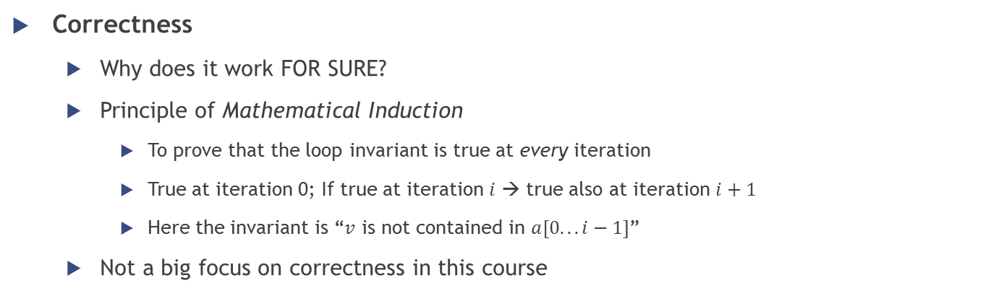
Array - Sequential search
FOR i = 0 TO N-1
IF a[i] = v
RETURN i
RETURN -1
Correctness
Why does it work FOR SURE?
Principle of Mathematical Induction
To prove that the loop invariant is true at every iteration
True at iteration 0; If true at iteration $i$ → true also at iteration $i+1$
Here the invariant is “$v$ is not contained in $a[0.. . i−1]$”
Not a big focus on correctness in this course

Slide 19
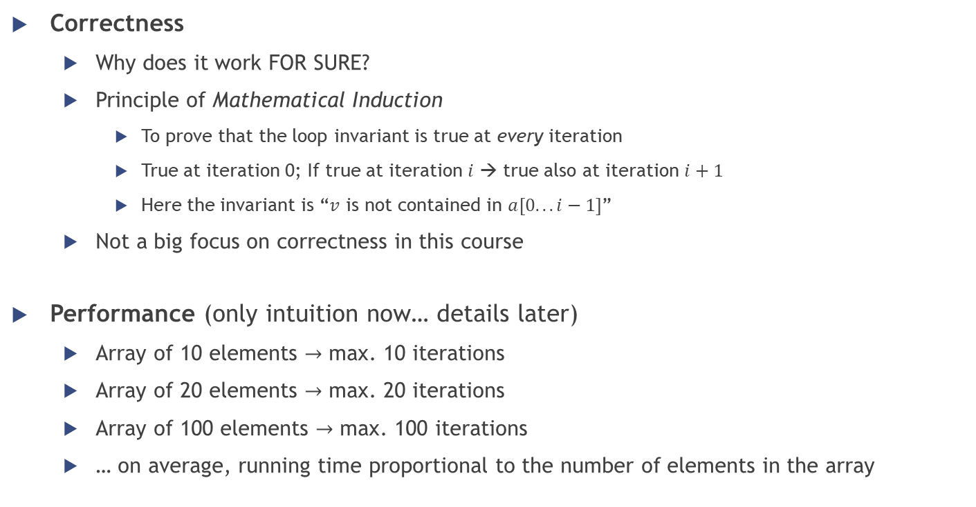
Array - Sequential search
FOR i = 0 TO N-1
IF a[i] = v
RETURN i
RETURN -1
Correctness
Why does it work FOR SURE?
Principle of Mathematical Induction
To prove that the loop invariant is true at every iteration
True at iteration 0; If true at iteration $i$ → true also at iteration $i+1$
Here the invariant is “$v$ is not contained in $a[0.. . i−1]$”
Not a big focus on correctness in this course
Performance (only intuition now… details later)
Array of 10 elements $→$ max. 10 iterations
Array of 20 elements $→$ max. 20 iterations
Array of 100 elements $→$ max. 100 iterations
… on average, running time proportional to the number of elements in the array

Slide 20
Array – Binary search
Standard search algorithm for a SORTED sequence
More efficient than sequential search
Requires the order of elements
Basic idea: divide the sequence in two and focus on the half which could contain the element
Application example: looking up a word in a dictionary

Slide 21
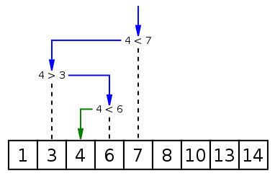
Array – Binary search
Pseudo-code [iterative version]
Look for the value v in the array a
Return -1 if v is not found
low = 0; high = N-1
WHILE low <= high
middle = (low + high) / 2
IF v < a[middle]
high = middle – 1
ELSE IF v > a[middle]
low = middle + 1
ELSE
RETURN middle
RETURN -1
low
middle
high

Slide 22
Array – Binary search
Pseudo-code [iterative version]
Look for the value v in the array a
Return -1 if v is not found
low = 0; high = N-1
WHILE low <= high
middle = (low + high) / 2
IF v < a[middle]
high = middle – 1
ELSE IF v > a[middle]
low = middle + 1
ELSE
RETURN middle
RETURN -1
low
middle
high
low
middle
high

Slide 23
Array – Binary search
Pseudo-code [iterative version]
Look for the value v in the array a
Return -1 if v is not found
low = 0; high = N-1
WHILE low <= high
middle = (low + high) / 2
IF v < a[middle]
high = middle – 1
ELSE IF v > a[middle]
low = middle + 1
ELSE
RETURN middle
RETURN -1
low
middle
high
low
high
middle

Slide 24
Array – Binary search
Pseudo-code [recursive version]
Look for the value v in the array a
Return -1 if v is not found
First call?
BinSearch(a, 0, N-1, v)
BinSearch(a, low, high, v)
IF low > high
RETURN -1
middle = (low + high) / 2
IF a[middle] > v
BinSearch(a, low, middle – 1, v)
ELSE IF a[middle] < v
BinSearch(a, middle + 1, high, v)
ELSE
RETURN middle

Slide 25
Array – Binary search
Performance
More complex to determine than in linear search
Given the number of elements N in the array, how many iterations will be done at most by the loop?

Slide 26
Performance of algorithms
Empirical analysis; Complexity analysis

Slide 27
Studying algorithms
Intuition
How does it work?
Invariant (correctness)
Why does it work? What are the fundamental properties that guarantee the correct answer?
Complexity
How fast is it, and how does it scale to very large inputs?
Through observation … Empirical analysis
Through reasoning … Complexity analysis

Slide 28
Empirical analysis

Slide 29

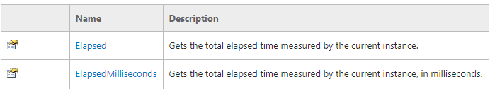


Empirical analysis
How to make quantitative measurements of the running time of our programs?
Using the Stopwatch!
If we execute a program more than once and/or on different machines, will it always have the same running time?
No!!! It depends on…
The PC on which it is executed
The “problem size”
Notes:
Problem size: size of the input / value of a command-line argument

Slide 30
Empirical analysis
More interesting question:
“How much does the running time of a program increase when the problem size increases?”
We look for a dependency/relationship between
Problem size
Running time

Slide 31
Empirical analysis
Example
a program (ThreeSum) which counts the triples in an array of N integers that sum to 0
Question
What is the relationship between the problem size N and the running time of ThreeSum?
Emiprical observations
N = 1000 → 0.1 seconds
N = 2000 → 0.8 seconds
N = 4000 → 6.4 seconds
N = 8000 → 51.1 seconds
…

Slide 32
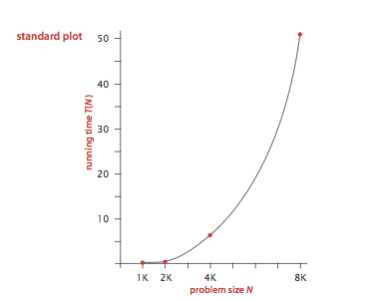
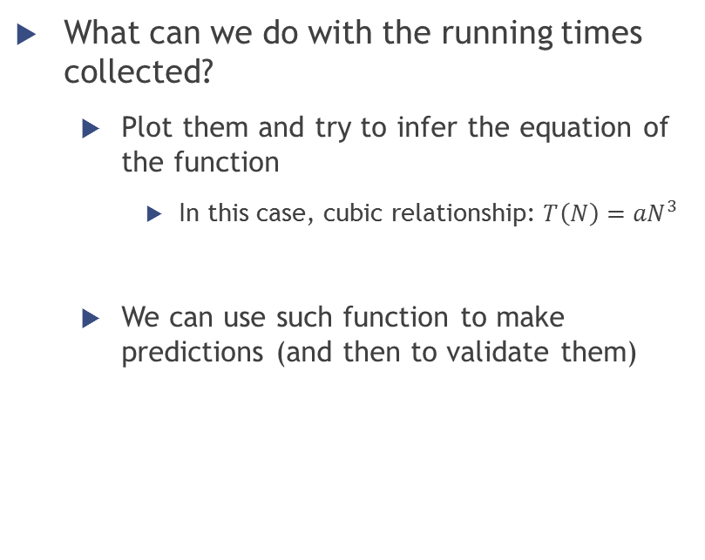
Empirical analysis
What can we do with the running times collected?
Plot them and try to infer the equation of the function
In this case, cubic relationship: ${T\left(N\right)=aN}^{3}$
We can use such function to make predictions (and then to validate them)

Slide 33
Empirical analysis
To get information on the performance of an algorithm, do we need to use the Stopwatch?
No!
It is possible to describe the running time of a program independently of concrete execution, by determining the frequency of execution of statements
Complexity analysis

Slide 34
Complexity analysis
Definition, Intuition, Examples
Notes:
http://bigocheatsheet.com/
http://stackoverflow.com/questions/487258/plain-english-explanation-of-big-o

Slide 35
Big O notation
A relative representation of the complexity of an algorithm
Scaling nature of an algorithm
how the resource use (mostly time) of an algorithm scales in response to the input size
worse case analysis: upper-bound of the resource use as N gets larger and larger (the algorithm will never take more space/time above that limit)
Why do we need it?
To compare the worse case performance of our algorithms in a standardized way

Slide 36
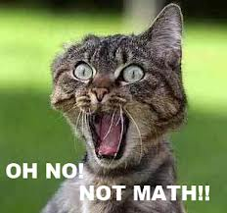
Big O notation

Slide 37
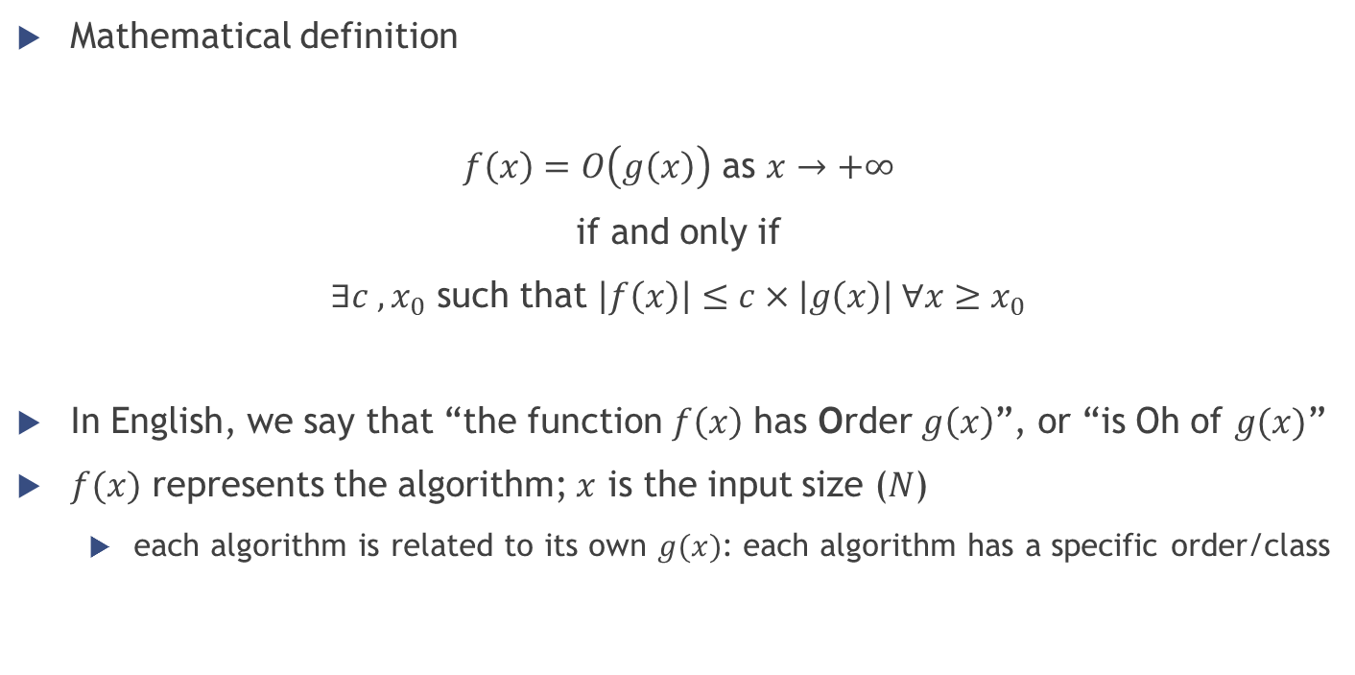
Big O notation
Mathematical definition
$f\left(x\right)=O\left(g\left(x\right)\right)$ as $x→+∞$
if and only if
$∃c , x_{0}$ such that $\left|f\left(x\right)\right|≤c×\left|g\left(x\right)\right| ∀x≥x_{0}$
In English, we say that “the function $f\left(x\right)$ has Order $g\left(x\right)$”, or “is Oh of $g(x)$”
$f(x)$ represents the algorithm; $x$ is the input size ($N$)
each algorithm is related to its own $g(x)$: each algorithm has a specific order/class

Slide 38
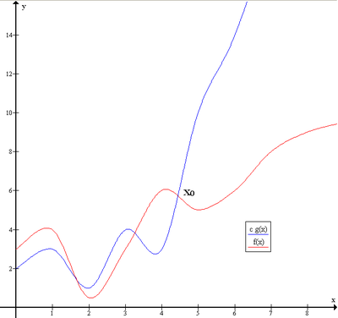

Big O notation
$f\left(x\right)=O\left(g\left(x\right)\right)$ as $x→+∞$
if and only if
$∃c , x_{0}$ such that $\left|f\left(x\right)\right|≤c×\left|g\left(x\right)\right| ∀x≥x_{0}$

Slide 39
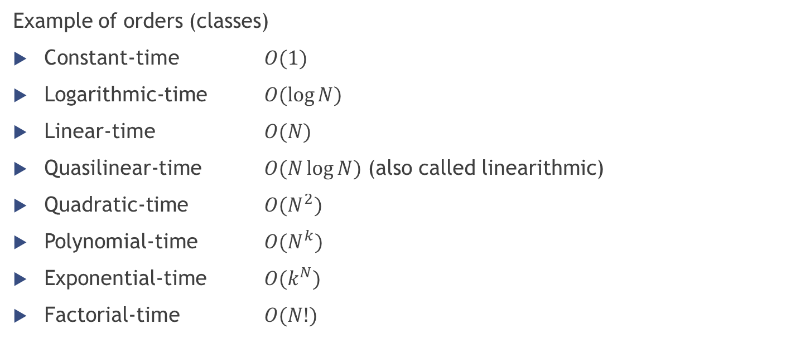
Big O notation
Example of orders (classes)
Constant-time $O(1)$
Logarithmic-time $O(\log{N})$
Linear-time $O(N)$
Quasilinear-time $O(N\log{N})$ (also called linearithmic)
Quadratic-time $O(N^{2})$
Polynomial-time $O(N^{k})$
Exponential-time $O(k^{N})$
Factorial-time $O(N!)$

Slide 40
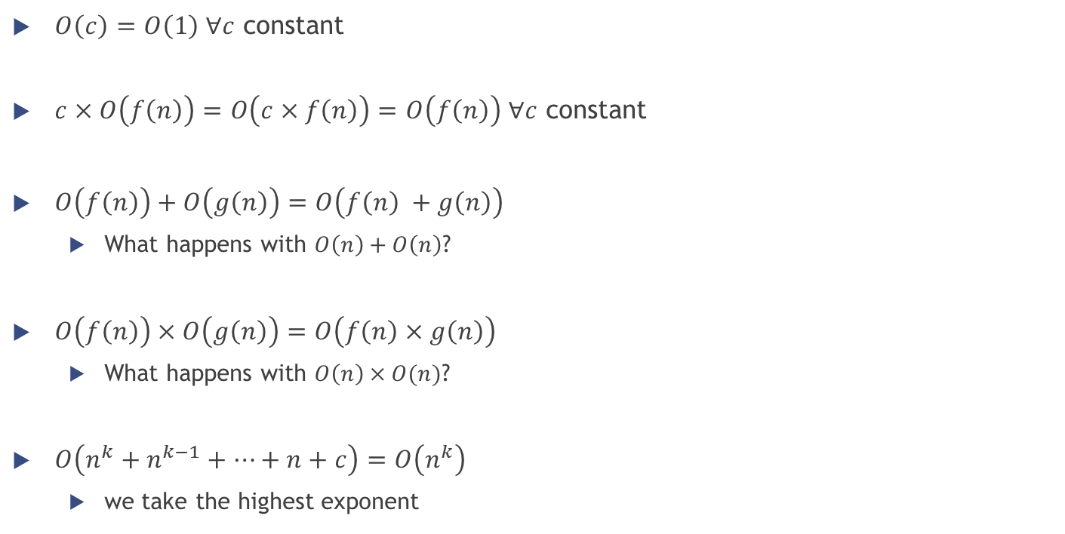
Operations with Big O notation
$O\left(c\right)=O\left(1\right) ∀c$ constant
$c×O\left(f\left(n\right)\right)=O\left(c×f\left(n\right)\right)=O\left(f\left(n\right)\right) ∀c$ constant
$O\left(f\left(n\right)\right)+O\left(g\left(n\right)\right)=O\left(f\left(n\right) +g\left(n\right)\right)$
What happens with $O\left(n\right)+O\left(n\right)$?
$O\left(f\left(n\right)\right)×O\left(g\left(n\right)\right)=O\left(f\left(n\right)×g\left(n\right)\right)$
What happens with $O\left(n\right)×O(n)$?
$O\left(n^{k}+n^{k−1}+…+n+c\right)=O\left(n^{k}\right)$
we take the highest exponent

Slide 41

Big O notation examples
$O(1)$
x[1] + y[4]

Slide 42

Big O notation examples
$O(1)$
FOR i = 1 TO 10
x += a[i]

Slide 43

Big O notation examples
$O(N)$
Summing all the elements of an array
x = 0
FOR i = 0 TO N-1
x += a[i]

Slide 44

Big O notation examples
$O(N)$
Sequential search in an array… remember?
FOR i = 0 TO N-1
IF a[i] = v
RETURN i
RETURN -1

Slide 45

Big O notation examples
$O(N)$
Computing the factorial of a number $N$
$$N!=N×\left(N−1\right)×\left(N−2\right)×…×1$$
Fact(N)
IF N = 0
1
ELSE
N $×$ Fact(N-1)

Slide 46

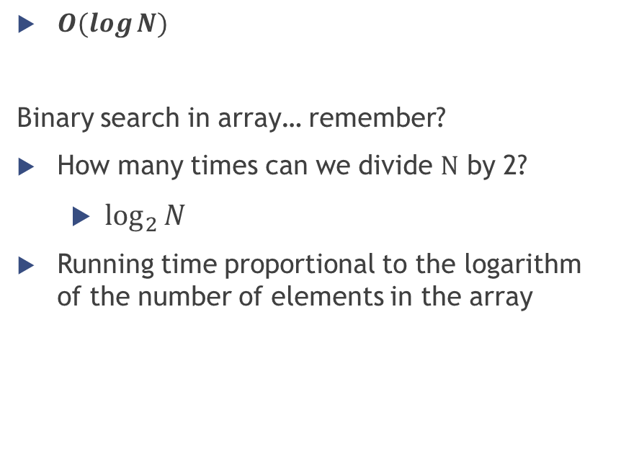
Big O notation examples
BinSearch(a, low, high, v)
IF low > high
RETURN -1
middle = (low + high) / 2
IF a[middle] > v
BinSearch(a, low, middle – 1, v)
ELSE IF a[middle] < v
BinSearch(a, middle + 1, high, v)
ELSE
RETURN middle
$O(\log{N})$
Binary search in array… remember?
How many times can we divide $N$ by 2?
$\log_{2}{N}$
Running time proportional to the logarithm of the number of elements in the array

Slide 47

Big O notation examples
$O(N^{2})$
FOR i = 1 TO N
FOR j = 1 TO N
v += i + j * N

Slide 48

Big O notation examples
$O\left(N^{3}\right)$
cnt = 0
FOR i = 1 TO N
FOR j = i+1 TO N
FOR k = j+1 TO N
IF a[i] + a[j] + a[k] == 0
cnt++

Slide 49
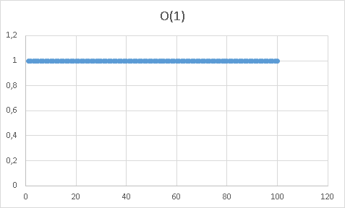
Big O notation comparison

Slide 50
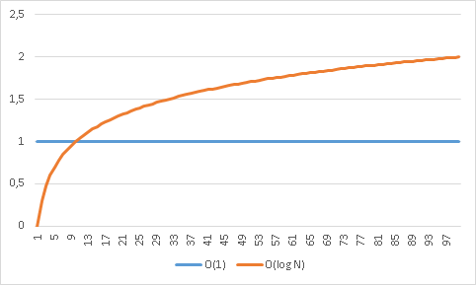
Big O notation comparison

Slide 51
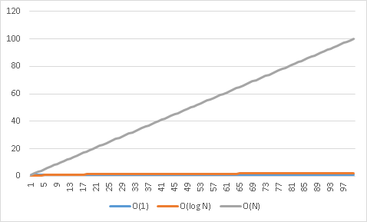
Big O notation comparison

Slide 52
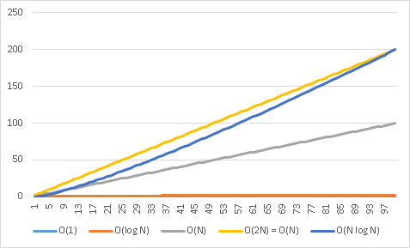
Big O notation comparison

Slide 53
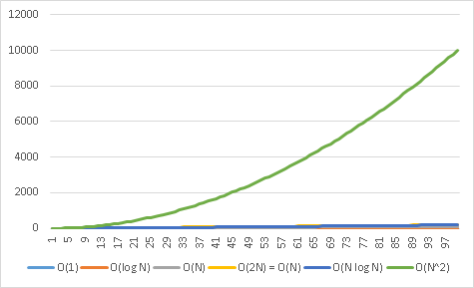
Big O notation comparison

Slide 54
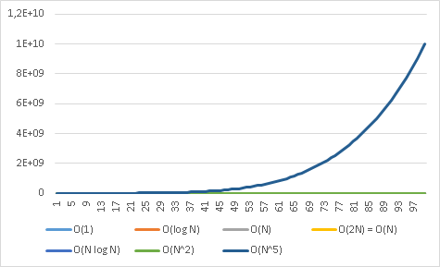
Big O notation comparison

Slide 55
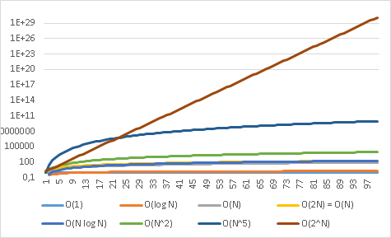
Big O notation comparison

Slide 56
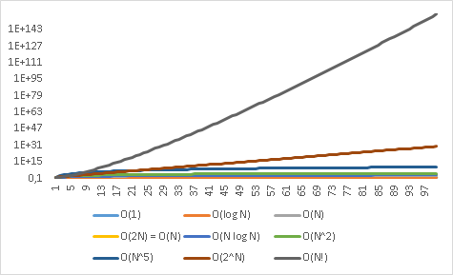
Big O notation comparison

Slide 57
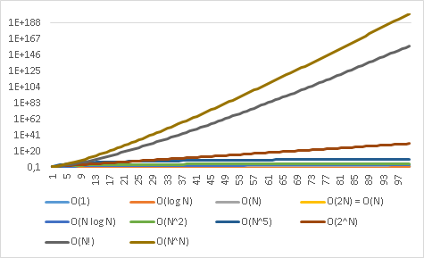
Big O notation comparison

Slide 58
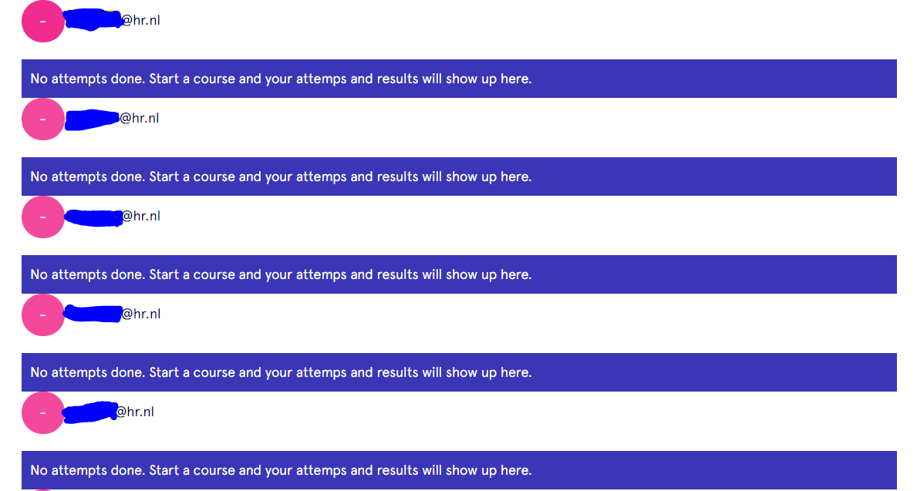
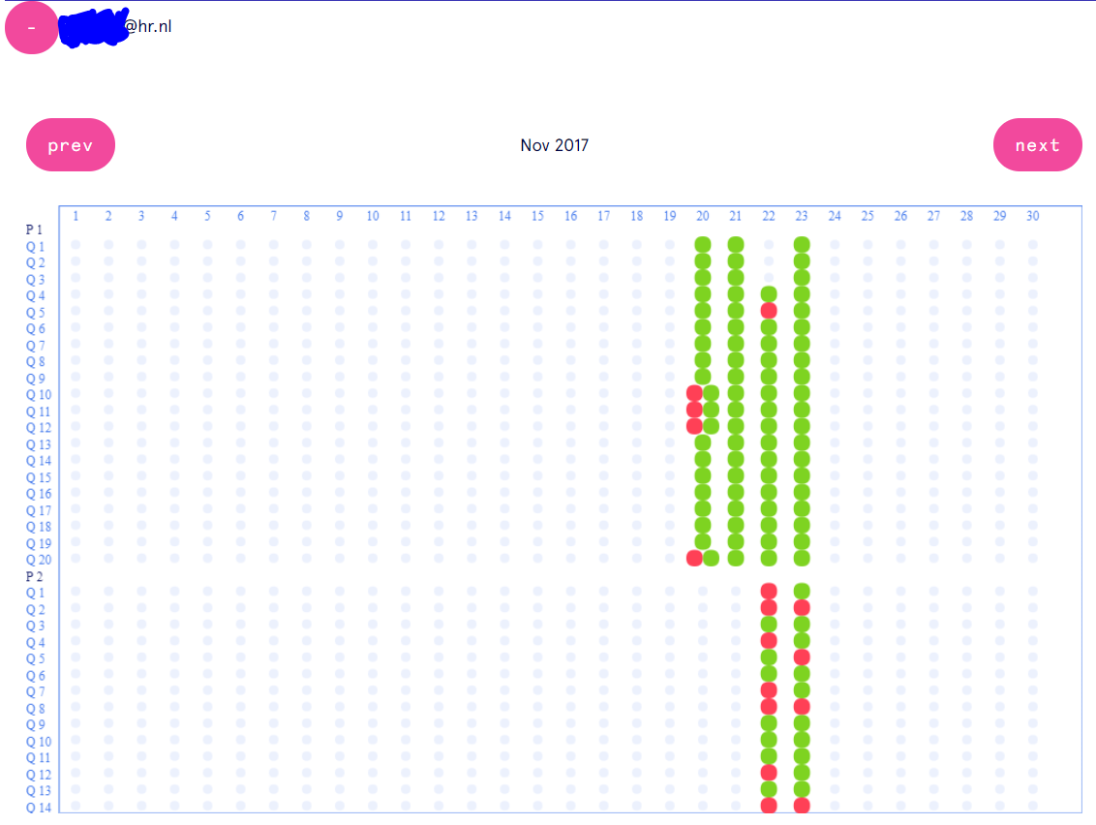
Homework
Multiple choice questions on GrandeOmega
Practice using C#
Implement linear search and binary search
Read modulewijzer
Study the slides
… See you next week ☺

